Slide 1
When You CREATE It

Slide 2
When You USE It

Slide 3
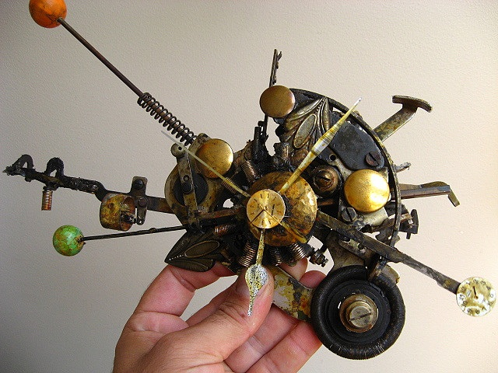
When You FILE It

Slide 4
Avoid Lawsuits- File It!

Slide 5
TRIPS
Berne Convention
Madrid Protocol
USPTO.gov
Copyright.gov
oami.europa.eu

Slide 6
Coypghrits and Trdemrask
Screw it up? Just Refile

Slide 7
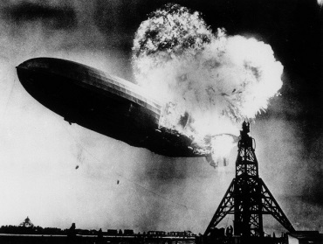
Patents- Screw It Up?

Slide 8
Trade Secrets & Proprietary Info
Protect It or Lose It!

Slide 9
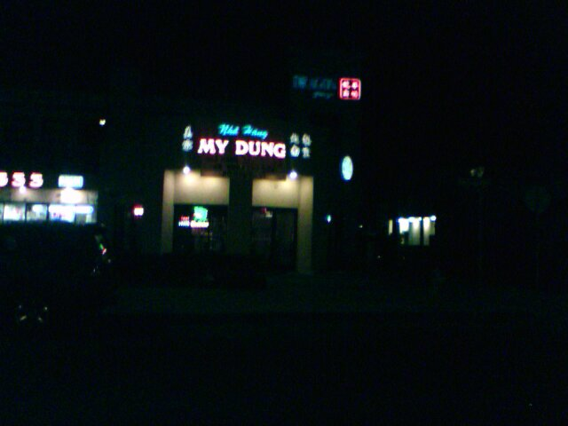
Trade Mark? Trade Name? Service? Cyber?

