Slide 1
Investors/Investment Stages

Slide 2
Investors
OPM Other People’s Money eg VCs | Brokers eg. Investment Bankers | Own Money Accredited Investors F&F Angels?!

Slide 3
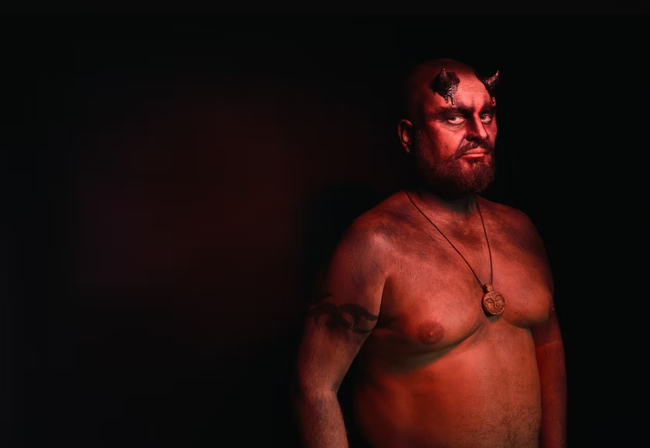

Slide 5
VC

Slide 6
Venture Capital
≠
Venture Capitalist

Slide 7
Accelerators/ Incubators
Investors
Grants- eg. JEREMIE FUND
VC Participation
Accelerator
Fund Appropriate Projects - Startups, IT Businesses, Agriculture, etc.

Slide 10
VC
Founders
2d Offering
New Money
VC
Founders

Slide 11
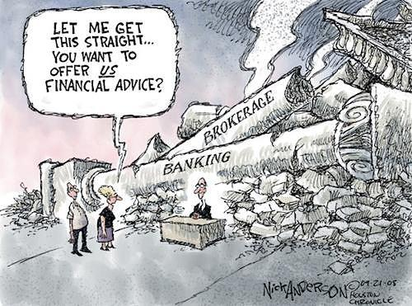

Slide 12
Accredited Investors
-$200,000 income for past 2 years
-$1,000,000 net worth (excluding home)
-investment advisers, fund managers, some investment companies, etc.
-Sophisticated Investors!!??

Slide 16
The Money Show
https://www.moneyshow.com/expert/1151spk/steve-forbes/
https://www.moneyshow.com/live-events/face-to-face/

Slide 17
Crowd Funding

Slide 18
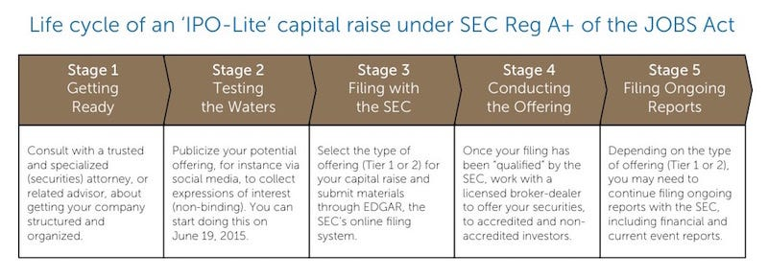
https://www.forbes.com/sites/mraneri/2015/05/26/testing-the-waters-and-filing-a-regulation-a-offering-with-the-sec/?sh=7fbdea051348

Slide 19
Non-Equity Crowd Funding

Slide 20
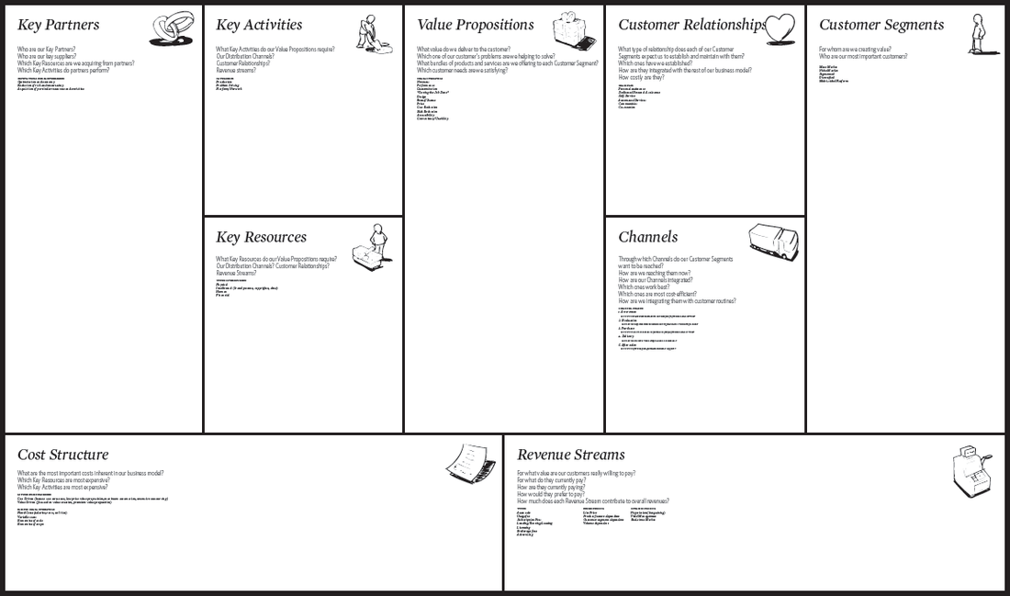

Slide 21
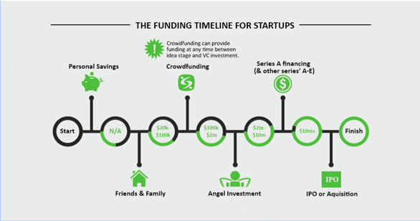

Slide 22
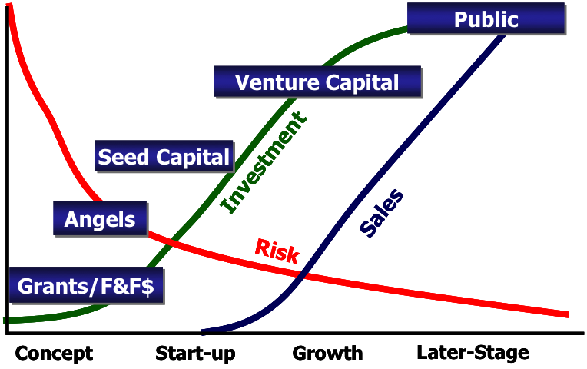

Slide 23
