Slide 1
e l e v e n t h e d i t i o n
o r g a n i z a t i o n a l b e h a v i o r

Slide 2
Chapter 8
Foundations of Group Behavior

Slide 3
After studying this chapter, you should be able to:
Differentiate between formal and informal groups.
Compare two models of group development.
Explain how role requirements change in different situations.
Describe how norms exert influence on an individual’s behavior.
Explain what determines status
Define social loafing and its effect on group performance.
L E A R N I N G O B J E C T I V E S
© 2005 Prentice Hall Inc. All rights reserved.
8–2

Slide 4
After studying this chapter, you should be able to:
Identify the benefits and disadvantages of cohesive groups.
List the strengths and weaknesses of group decision making.
Contrast the effectiveness of interacting, brainstorming, nominal and electronic meeting groups.
L E A R N I N G O B J E C T I V E S (cont’d)
© 2005 Prentice Hall Inc. All rights reserved.
8–3

Slide 5
Defining and Classifying Groups
Group(s)
Two or more individuals interacting and interdependent, who have come together to achieve particular objectives.
Formal Group
A designated work group defined by the organization’s structure.
Informal Group
A group that is neither formally structured now organizationally determined; appears in response to the need for social contact.
© 2005 Prentice Hall Inc. All rights reserved.
8–4

Slide 6
Defining and Classifying Groups (cont’d)
Command Group
A group composed of the individuals who report directly to a given manager.
Task Group
Those working together to complete a job or task.
Interest Group
Those working together to attain a specific objective with which each is concerned.
Friendship Group
Those brought together because they share one or more common characteristics.
© 2005 Prentice Hall Inc. All rights reserved.
8–5

Slide 7
Why People Join Groups
Security
Status
Self-esteem
Affiliation
Power
Goal Achievement
E X H I B I T 8–1
© 2005 Prentice Hall Inc. All rights reserved.
8–6

Slide 8
The Five-Stage Model of Group Development
Forming Stage The first stage in group development, characterized by much uncertainty.
Storming Stage The second stage in group development, characterized by intragroup conflict.
Norming Stage The third stage in group development, characterized by close relationships and cohesiveness.
© 2005 Prentice Hall Inc. All rights reserved.
8–7

Slide 9
…Group Development (cont’d)
Performing Stage
The fourth stage in group development, when the group is fully functional.
Adjourning Stage
The final stage in group development for temporary groups, characterized by concern with wrapping up activities rather than performance.
© 2005 Prentice Hall Inc. All rights reserved.
8–8

Slide 10
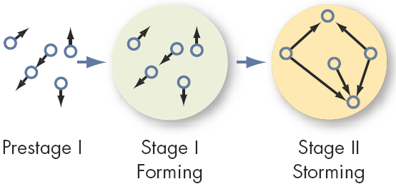
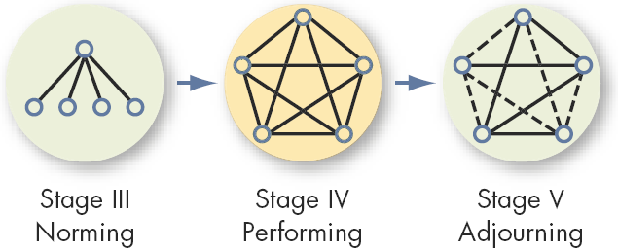
Stages of Group Development
E X H I B I T 8–2
© 2005 Prentice Hall Inc. All rights reserved.
8–9

Slide 11
An Alternative Model: Temporary Groups with Deadlines
Punctuated-Equilibrium Model
Temporary groups go through transitions between inertia and activity.
Sequence of actions:
Setting group direction
First phase of inertia
Half-way point transition
Major changes
Second phase of inertia
Accelerated activity
© 2005 Prentice Hall Inc. All rights reserved.
8–10

Slide 12
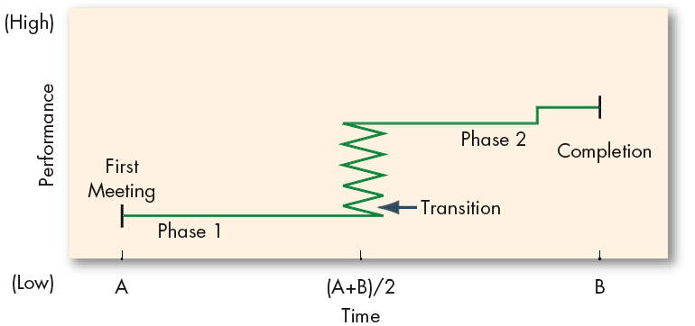
The Punctuated-Equilibrium Model
E X H I B I T 8–3
© 2005 Prentice Hall Inc. All rights reserved.
8–11

Slide 13
Group Structure - Roles (cont’d)
Role(s)
A set of expected behavior patterns attributed to someone occupying a given position in a social unit.
Role Identity
Certain attitudes and behaviors consistent with a role.
Role Perception
An individual’s view of how he or she is supposed to act in a given situation.
© 2005 Prentice Hall Inc. All rights reserved.
8–12

Slide 14
Group Structure - Roles (cont’d)
Role Expectations
How others believe a person should act in a given situation.
Psychological Contract
An unwritten agreement that sets out what management expects from the employee and vice versa.
Role Conflict
A situation in which an individual is confronted by divergent role expectations.
© 2005 Prentice Hall Inc. All rights reserved.
8–13

Slide 15
Group Structure - Norms
Norms
Acceptable standards of behavior within a group that are shared by the group’s members.
Classes of Norms:
Performance norms
Appearance norms
Social arrangement norms
Allocation of resources norms
© 2005 Prentice Hall Inc. All rights reserved.
8–14

Slide 16
The Hawthorne Studies
A series of studies undertaken by Elton Mayo at Western Electric Company’s Hawthorne Works in Chicago between 1924 and 1932.
Research Conclusions:
Worker behavior and sentiments were closely related.
Group influences (norms) were significant in affecting individual behavior.
Group standards (norms) were highly effective in establishing individual worker output.
Money was less a factor in determining worker output than were group standards, sentiments, and security.
© 2005 Prentice Hall Inc. All rights reserved.
8–15

Slide 17
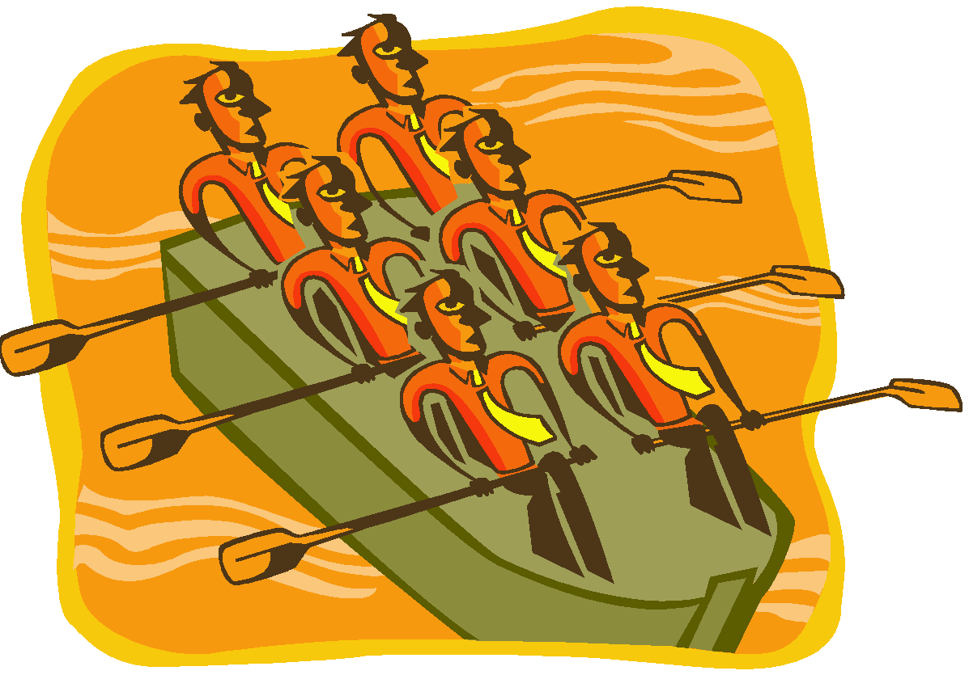
Group Structure - Norms (cont’d)
Conformity
Adjusting one’s behavior to align with the norms of the group.
Reference Groups
Important groups to which individuals belong or hope to belong and with whose norms individuals are likely to conform.
© 2005 Prentice Hall Inc. All rights reserved.
8–16

Slide 18
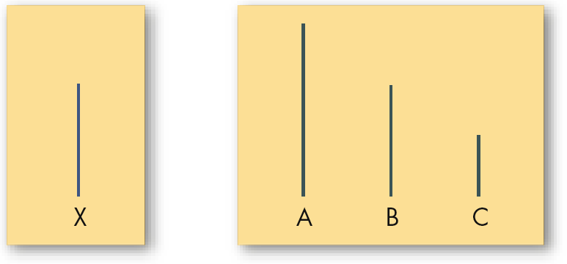
Examples of Cards Used in Asch’s Study
E X H I B I T 8–4
© 2005 Prentice Hall Inc. All rights reserved.
8–17

Slide 19
Group Structure - Norms (cont’d)
Deviant Workplace Behavior
Antisocial actions by organizational members that intentionally violate established norms and result in negative consequences for the organization, its members, or both.
© 2005 Prentice Hall Inc. All rights reserved.
8–18

Slide 20
Typology of Deviant Workplace Behavior
Category Examples Production Leaving early Intentionally working slowly Wasting resources
Property Sabotage Lying about hours worked Stealing from the organization
Political Showing favoritism Gossiping and spreading rumors Blaming coworkers
Personal Aggression Sexual harassment Verbal abuse Stealing from coworkers
Source: Adapted from S.L. Robinson, and R.J. Bennett. “A Typology of Deviant Workplace Behaviors: A Multidimensional Scaling Study,” Academy of Management Journal, April 1995, p. 565.
E X H I B I T 8–5
© 2005 Prentice Hall Inc. All rights reserved.
8–19

Slide 21
Group Structure - Status
Status
A socially defined position or rank given to groups or group members by others.
Group Norms
Status Equity
Group Member Status
Culture
© 2005 Prentice Hall Inc. All rights reserved.
8–20

Slide 22
Group Structure - Size
Social Loafing The tendency for individuals to expend less effort when working collectively than when working individually.
Performance
Other conclusions:
Odd number groups do better than even.
Groups of 7 or 9 perform better overall than larger or smaller groups.
Expected
Actual (due to loafing)
Group Size
© 2005 Prentice Hall Inc. All rights reserved.
8–21

Slide 23
Group Structure - Composition
Group Demography
The degree to which members of a group share a common demographic attribute, such as age, sex, race, educational level, or length of service in the organization, and the impact of this attribute on turnover.
Cohorts
Individuals who, as part of a group, hold a common attribute.
© 2005 Prentice Hall Inc. All rights reserved.
8–22

Slide 24
Group Structure - Cohesiveness
Cohesiveness
Degree to which group members are attracted to each other and are motivated to stay in the group.
Increasing group cohesiveness:
Make the group smaller.
Encourage agreement with group goals.
Increase time members spend together.
Increase group status and admission difficultly.
Stimulate competition with other groups.
Give rewards to the group, not individuals.
Physically isolate the group.
© 2005 Prentice Hall Inc. All rights reserved.
8–23

Slide 25
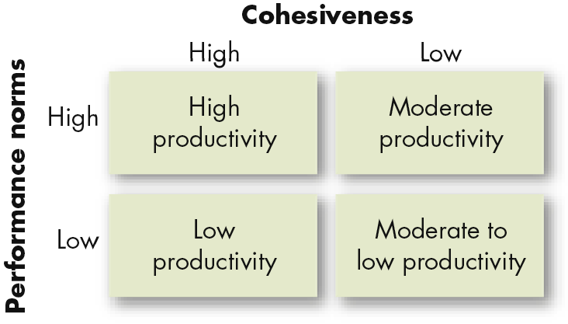
Relationship Between Group Cohesiveness, Performance Norms, and Productivity
E X H I B I T 8–6
© 2005 Prentice Hall Inc. All rights reserved.
8–24

Slide 26
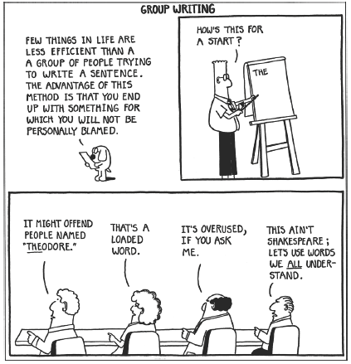
S. Adams, Build a Better Life by Stealing Office Supplies (Kansas City MO: Andrews & McMeal, 1991), p. 31. Dilbert reprinted with permission of United Features Syndicate, Inc.
E X H I B I T 8–7
© 2005 Prentice Hall Inc. All rights reserved.
8–25

Slide 27
Group Tasks
Decision-making
Large groups facilitate the pooling of information about complex tasks.
Smaller groups are better suited to coordinating and facilitating the implementation of complex tasks.
Simple, routine standardized tasks reduce the requirement that group processes be effective in order for the group to perform well.
© 2005 Prentice Hall Inc. All rights reserved.
8–26

Slide 28
Group Decision Making
Strengths
More complete information
Increased diversity of views
Higher quality of decisions (more accuracy)
Increased acceptance of solutions
Weaknesses
More time consuming (slower)
Increased pressure to conform
Domination by one or a few members
Ambiguous responsibility
© 2005 Prentice Hall Inc. All rights reserved.
8–27

Slide 29
Group Decision Making (cont’d)
Groupthink
Phenomenon in which the norm for consensus overrides the realistic appraisal of alternative course of action.
Groupshift
A change in decision risk between the group’s decision and the individual decision that member within the group would make; can be either toward conservatism or greater risk.
© 2005 Prentice Hall Inc. All rights reserved.
8–28

Slide 30
Symptoms Of The Groupthink Phenomenon
Group members rationalize any resistance to the assumptions they have made.
Members apply direct pressures on those who express doubts about shared views or who question the alternative favored by the majority.
Members who have doubts or differing points of view keep silent about misgivings.
There appears to be an illusion of unanimity.
© 2005 Prentice Hall Inc. All rights reserved.
8–29

Slide 31
Group Decision-Making Techniques
Interacting Groups
Typical groups, in which the members interact with each other face-to-face.
Nominal Group Technique
A group decision-making method in which individual members meet face-to-face to pool their judgments in a systematic but independent fashion.
© 2005 Prentice Hall Inc. All rights reserved.
8–30

Slide 32
Group Decision-Making Techniques
Brainstorming
An idea-generation process that specifically encourages any and all alternatives, while withholding any criticism of those alternatives.
Electronic Meeting
A meeting in which members interact on computers, allowing for anonymity of comments and aggregation of votes.
© 2005 Prentice Hall Inc. All rights reserved.
8–31

Slide 33
Evaluating Group Effectiveness
TYPE OF GROUP
Effectiveness Criteria Interacting Brainstorming Nominal Electronic
Number and quality of ideas Low Moderate High High
Social pressure High Low Moderate Low
Money costs Low Low Low High
Speed Moderate Moderate Moderate Moderate
Task orientation Low High High High
Potential for interpersonal conflict High Low Moderate Low
Commitment to solution High Not applicable Moderate Moderate
Development of High High Moderate Low group cohesiveness
E X H I B I T 8–8
© 2005 Prentice Hall Inc. All rights reserved.
8–32

