Slide 1
Management and Organisational Behaviour
7th Edition
CHAPTER 11
The Process of Perception

Slide 2
Perception
The dynamic & complex way in which individuals select information (stimuli) from the environment, interpret & translate it so that a meaning is assigned that will result in a pattern of behaviour or thought

Slide 3
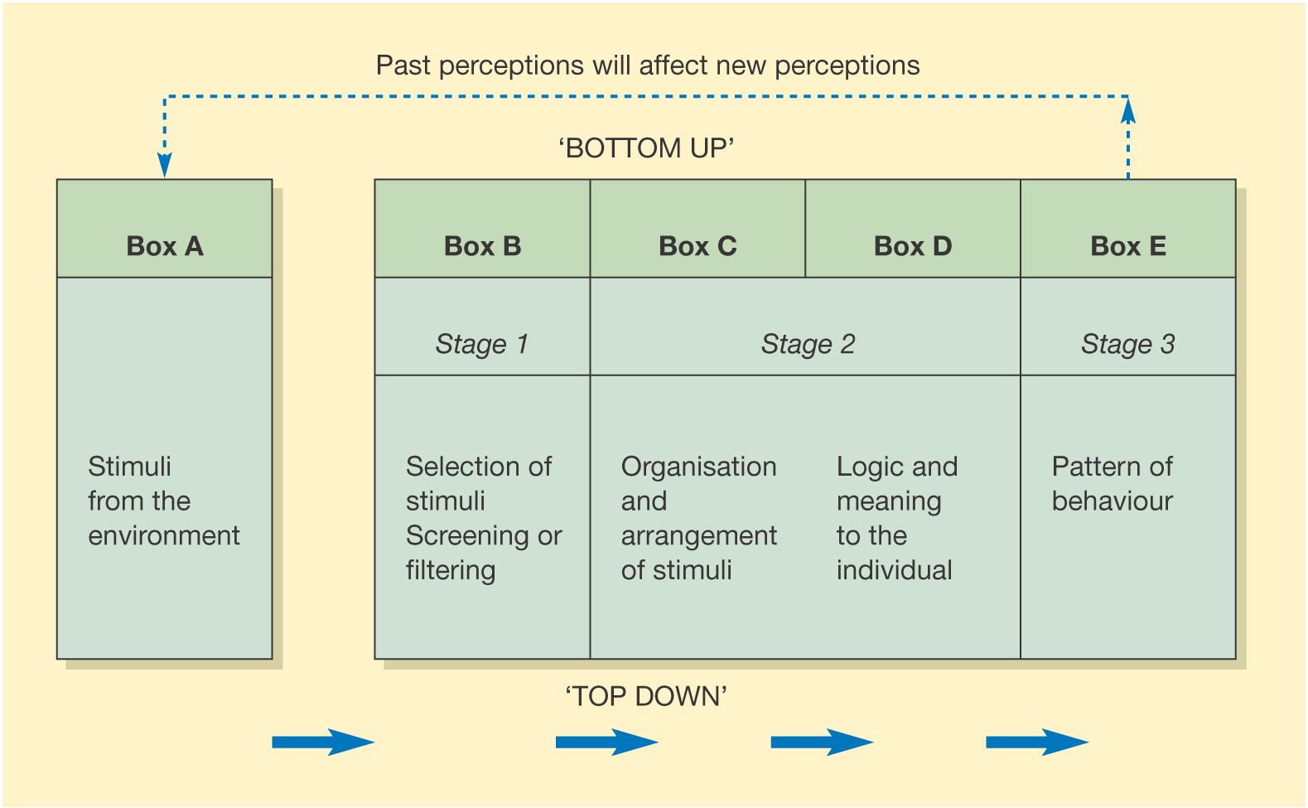
Figure 11.1
Perceptions as information processing

Slide 4
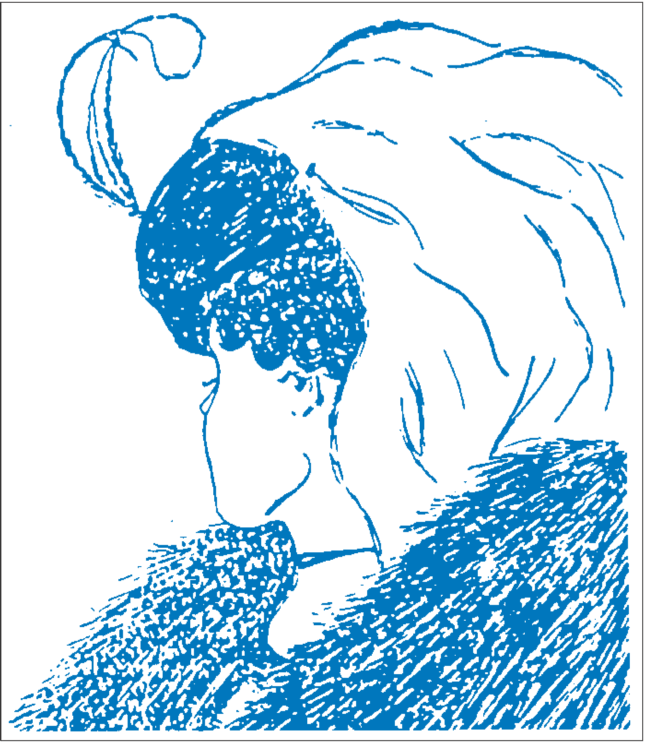
Figure 11.2
Versions of what we see

Slide 5
Process of perceptual selection
The first process of perception is selection & attention
The process of perceptual selection is based on internal factors & external factors
Internal – relating to the state of the individual
External – the environment

Slide 6
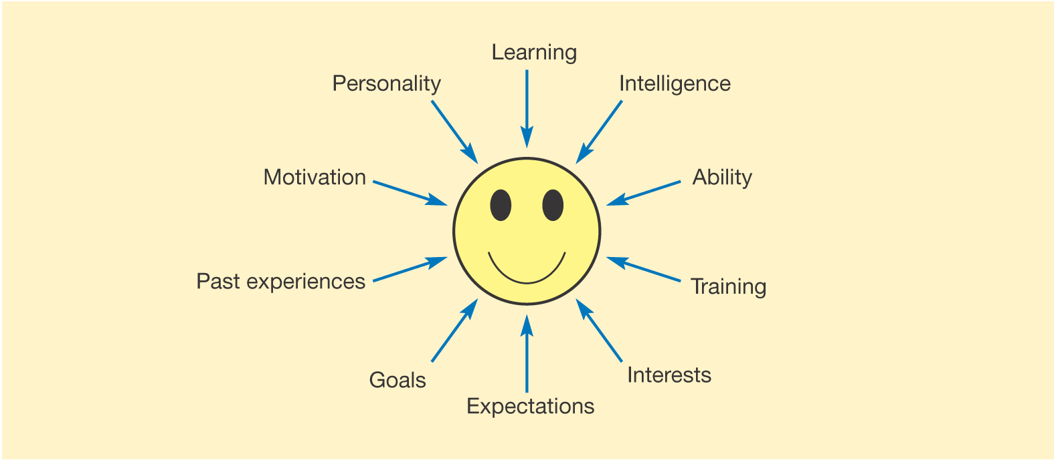
Figure 11.3
Factors affecting an individual’s perceptual set

Slide 7
Importance of language
Language:
Labels & distinguishes our environment
Structures & guides our thinking patterns
Is part of the culture we experience and learn to take for granted
Influences our relationships with others and with the environment
Reflects our experiences

Slide 8
Cultural differences
The way people interact is also subject to cultural differences and these can be misconstrued
The ways in which words are used and assumptions made about shared understanding are dependent on a person’s culture and upbringing

Slide 9
Organisation & the arrangement of stimuli
The Gestalt school claimed that the process of perception is innately organised & patterned
Gestalts claimed that the human brain acts like a dynamic, physical field in which interaction among elements is an intrinsic part

Slide 10
The Gestalt school
The Gestalt school produced a series of principles:
Figure & ground – figures are seen against a background
Grouping – a tendency to organise patterns & shapes instantly into meaningful grouping of patterns on the basis of their proximity or similarity
Closure – the tendency to complete an incomplete picture, to mentally fill in the gaps and perceive a figure as a whole

Slide 11
Perceptual illusions
Our brains can be fooled
People make assumptions about things that go beyond the pure sensations our brain receives

Slide 12
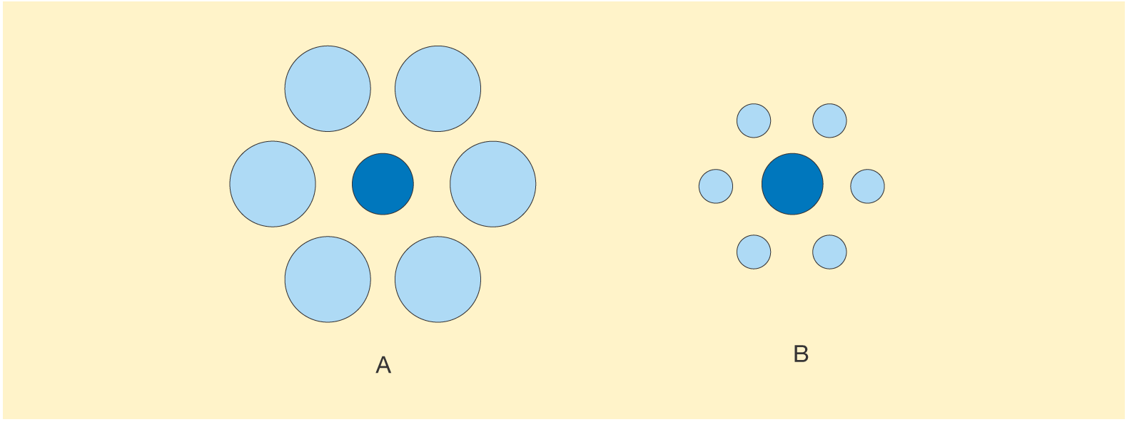
Figure 11.9
Perceptual illusions

Slide 13
Perceiving other people
The process of perception and the selection of stimuli can influence a manager’s relationships with other staff.
For example:
Grouping – the way in which a manager may think of a group of staff
Figure & ground – a manager may notice a new recruit & set that person apart from the rest because of particular characteristics such as appearance
Closure – the degree to which unanimity is perceived

Slide 14
Perceiving other people
A manager’s perception of the workforce will influence attitudes in dealing with people & the style of managerial behaviour adopted
A manager’s approach to work & others is likely to be conditioned by predispositions about people, human nature & work
The perception of people’s performance can be affected by the organisation of stimuli

Slide 15
Transactional analysis (TA)
A popular way of explaining the dynamics of interpersonal communication
A theory which encompasses personality, perception, & communication
Has been successfully used by organisations as a training & development programme
Has two underlying assumptions

Slide 16
Transactional analysis (TA) underlying assumptions
All the events & feelings experienced are stored within us & can be replayed so we can re-experience events & the feelings of all our past years
Personality is made up of three ego states that are revealed in distinct ways of behaviour (tone of voice, actions, etc.)

Slide 17
Ego states
Child – behaviour that demonstrates the feelings we remember as a child
Adult – behaviour which concerns our thought processes & the processing of facts & information
Parent – behaviour which concerns the attitudes, feelings, & behaviour incorporated from external sources, primarily our parents
Berne

Slide 18
Behaviour & ego states examples
Continually advising & criticising others
Analysing, dealing only with facts, distrusting own feelings
Constantly clowning around or being consumed with anger
Parent
Adult
Child

Slide 19
Selecting information
Verbal – what is said
Non verbal –
Bodily contact
Proximity to others
Posture
Head nods
Facial expression
Gestures
Direction of gazes, etc.

Slide 20
Distinguishing information according to Cook
Static information – information that will not change during the encounter, for example, colour, gender, height, age
Dynamic information – information that is subject to change, for example, mood, posture, gestures and expressions Cook

Slide 21
Judgement
Judgement of other people can be influenced by -
Previous experiences & learning
Inferences & assumptions
What is known about the behaviour of others
Role or status
Occupation
Physical factors
Body language
Invasions of own space

Slide 22
Body language
Actions are more cogent than speech and humans rely heavily on body language to convey their true feelings & meanings
Whilst body language may be a guide to personality, errors can arise if too much is inferred from a single message

Slide 23
Attribution theory
Behaviour is determined by a combination of perceived internal & external forces
Internal forces
e.g. personal attributes such as ability, skills, amount of effort & fatigue
External forces
e.g. organisational rules & policies, the manner of superiors, the weather, etc.

Slide 24
Figure 11.13
Attribution theory

Slide 25
Stereotyping
The tendency to ascribe positive or negative characteristics to others on the basis of general categorisations and perceived similarities
A means of simplifying the process of perception and making judgements of other people, instead of dealing with a range of complex and alternative stimuli

Slide 26
Common stereotypes
Common stereotypes may be based on –
Nationality
Occupation
Age
Physical attributes
Education
Social status
Politics

Slide 27
Halo effect
A process whereby a person’s perception is formed on the basis of a single favourable trait or impression
Tends to shut out other relevant characteristics of a person

Slide 28
Rusty halo effect
Judgements made about a person are formed from the perception of negative characteristics

