Slide 1
Understanding Individual Behavior
Lecture 2
13–1
Notes:
1

Slide 2
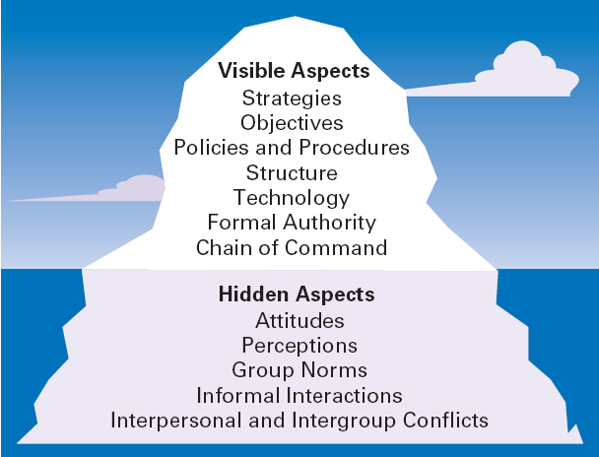
Exhibit 13.1 The Organization as an Iceberg
Copyright © 2010 Pearson Education, Inc. Publishing as Prentice Hall
13–2
Notes:
2

Slide 3
The Focus and Goals of Individual Behavior
Organizational Behavior (OB)
The actions of people at work
Focus of Organizational Behavior
Individual behavior
Attitudes, personality, perception, learning, and motivation
Group behavior
Norms, roles, team building, leadership, and conflict
Organizational
Structure, culture, and human resource policies and practices
Copyright © 2010 Pearson Education, Inc. Publishing as Prentice Hall
13–3
Notes:
3

Slide 4
Goals of Organizational Behavior
To explain, predict and influence behavior.
Employee Productivity
A performance measure of both efficiency and effectiveness
Absenteeism
The failure to report to work when expected
Turnover
The voluntary and involuntary permanent withdrawal from an organization
Copyright © 2010 Pearson Education, Inc. Publishing as Prentice Hall
13–4
Notes:
4

Slide 5
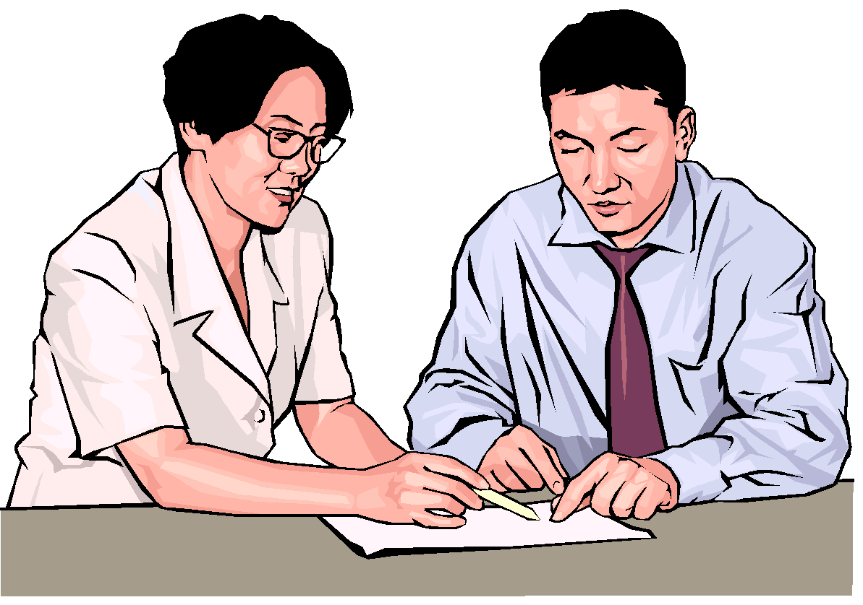
Important Employee Behaviors (cont’d)
Organizational Citizenship Behavior (OCB)
Discretionary behavior that is not a part of an employee’s formal job requirements, but which promotes the effective functioning of the organization.
Job Satisfaction
The individual’s general attitude toward his or her job
Copyright © 2010 Pearson Education, Inc. Publishing as Prentice Hall
13–5
Notes:
5

Slide 6
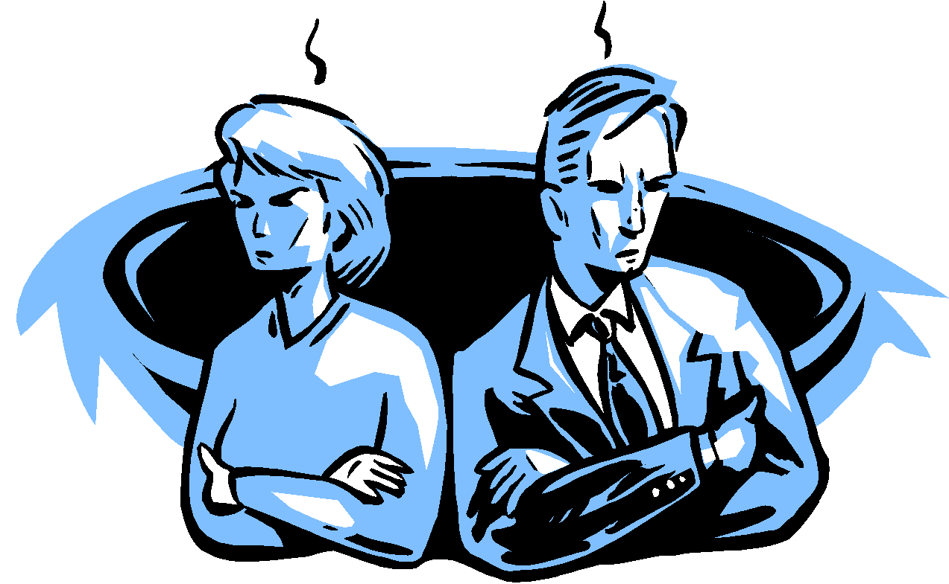
Important Employee Behaviors (cont’d)
Workplace Misbehavior
Any intentional employee behavior that has negative consequences for the organization or individuals within the organization.
Types of Misbehavior
Deviance
Aggression
Antisocial behavior
Violence
Copyright © 2010 Pearson Education, Inc. Publishing as Prentice Hall
13–6
Notes:
6

Slide 7
Psychological Factors Affecting Employee Behavior
Employee Productivity
Absenteeism
Turnover
Organizational Citizenship
Job Satisfaction
Workplace Misbehavior
Attitudes
Personality
Perception
Learning
Copyright © 2010 Pearson Education, Inc. Publishing as Prentice Hall
13–7
Notes:
7

Slide 8
Psychological Factors – Attitudes
Attitudes
Evaluative statements—either favorable or unfavorable—concerning objects, people, or events.
Components of an Attitude
Cognitive component: the beliefs, opinions, knowledge, or information held by a person.
Affective component: the emotional or feeling part of an attitude.
Behavioral component: the intention to behave in a certain way.
Copyright © 2010 Pearson Education, Inc. Publishing as Prentice Hall
13–8
Notes:
8

Slide 9
Psychological Factors – Attitudes
Job Satisfaction
Job satisfaction is affected by level of income earned and by the type of job a worker does.
Job Satisfaction and Productivity
The correlation between satisfaction and productivity is fairly strong.
Organizations with more satisfied employees are more effective than those with fewer satisfied employees.
Copyright © 2010 Pearson Education, Inc. Publishing as Prentice Hall
13–9
Notes:
9

Slide 10
Psychological Factors – Attitudes
Job Satisfaction and Absenteeism
Satisfied employees tend to have lower levels of absenteeism, although satisfied employees are bound to take company approved days off (e.g. sick days)
Job Satisfaction and Turnover
Satisfied employees have lower levels of turnover; dissatisfied employees have higher levels of turnover.
Turnover is affected by the level of employee performance.
The preferential treatment afforded superior employees makes satisfaction less important in predicting their turnover decisions.
Copyright © 2010 Pearson Education, Inc. Publishing as Prentice Hall
13–10
Notes:
10

Slide 11
Psychological Factors – Attitudes
Job Satisfaction and Customer Satisfaction
The level of job satisfaction for frontline employees is related to increased customer satisfaction and loyalty.
Interaction with dissatisfied customers can increase an employee’s job dissatisfaction.
Actions to increase job satisfaction for customer service workers:
Hire upbeat and friendly employees.
Reward superior customer service.
Provide a positive work climate.
Use attitude surveys to track employee satisfaction.
Copyright © 2010 Pearson Education, Inc. Publishing as Prentice Hall
13–11
Notes:
11

Slide 12
Psychological Factors – Attitudes
Job Satisfaction and Organizational Citizenship Behavior (OCB)
Relationship between job satisfaction and OCB is tempered by perceptions of fairness
Individual OCB is influenced by work group OCB
Job Satisfaction and Workplace Misbehavior
Dissatisfied employees will respond somehow
Not easy to predict exactly how they’ll respond
Copyright © 2010 Pearson Education, Inc. Publishing as Prentice Hall
13–12

Slide 13
Psychological Factors – Attitudes
Job Involvement
The degree to which an employee identifies with his or her job, actively participates in it, and considers his or her performance to be important to his or her self-worth.
High levels of commitment are related to fewer absences and lower resignation rates.
Copyright © 2010 Pearson Education, Inc. Publishing as Prentice Hall
13–13

Slide 14
Psychological Factors – Attitudes
Organizational Commitment
Is the degree to which an employee identifies with a particular organization and its goals and wishes to maintain membership in the organization.
Leads to lower levels of both absenteeism and turnover.
Could be becoming an outmoded measure as the number of workers who change employers increases.
Copyright © 2010 Pearson Education, Inc. Publishing as Prentice Hall
13–14
Notes:
14

Slide 15
Psychological Factors – Attitudes
Perceived Organizational Support
Is the general belief of employees that their organization values their contribution and cares about their well-being.
Represents the commitment of the organization to the employee.
Providing high levels of support increases job satisfaction and lower turnover.
Copyright © 2010 Pearson Education, Inc. Publishing as Prentice Hall
13–15
Notes:
15

Slide 16
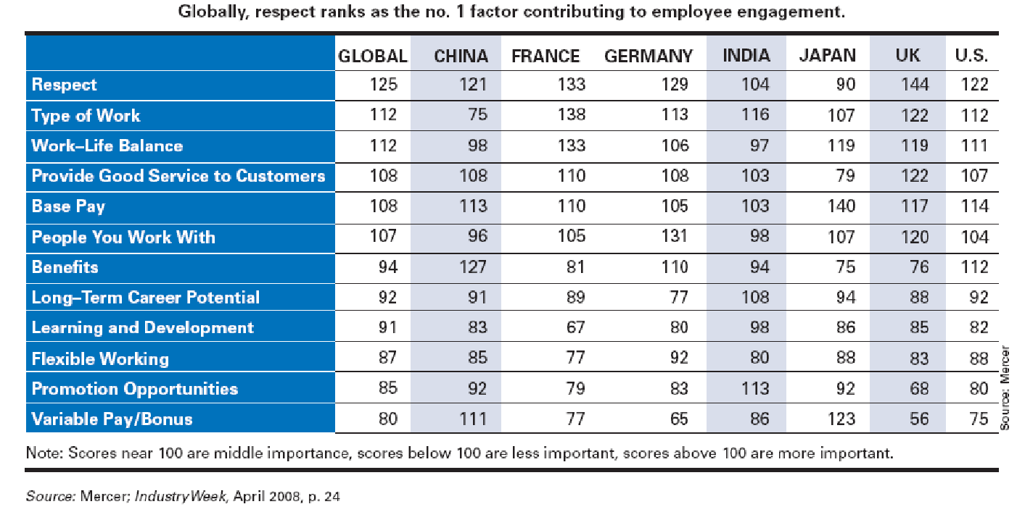
Exhibit 13–2 Key Employee Engagement Factors
Copyright © 2010 Pearson Education, Inc. Publishing as Prentice Hall
13–16

Slide 17
Attitudes and Consistency
People seek consistency in two ways:
Consistency among their attitudes.
Consistency between their attitudes and behaviors.
If an inconsistency arises, individuals:
Alter their attitudes or
Alter their behavior or
Develop a rationalization for the inconsistency
Copyright © 2010 Pearson Education, Inc. Publishing as Prentice Hall
13–17
Notes:
17

Slide 18
Cognitive Dissonance Theory
Cognitive Dissonance
Any incompatibility or inconsistency between attitudes or between behavior and attitudes.
Any form of inconsistency is uncomfortable and individuals will try to reduce the dissonance.
The intensity of the desire to reduce the dissonance is influenced by:
The importance of the factors creating the dissonance.
The degree to which an individual believes that the factors causing the dissonance are controllable.
Rewards available to compensate for the dissonance.
Copyright © 2010 Pearson Education, Inc. Publishing as Prentice Hall
13–18
Notes:
18

Slide 19
Attitude Surveys
Attitude Surveys
A instrument/document that presents employees with a set of statements or questions eliciting how they feel about their jobs, work groups, supervisors, or their organization.
Provide management with feedback on employee perceptions of the organization and their jobs.
Copyright © 2010 Pearson Education, Inc. Publishing as Prentice Hall
13–19
Notes:
19

Slide 20
Exhibit 13–3 Sample Employee Survey
To measure employee attitudes, some KFC and Long John Silver’s restaurants ask employees
to react to statements such as:
• My restaurant is a great place to work.
• People on my team help out, even if it is not their job.
• I am told whether I am doing good work or not.
• I understand the employee benefits that are available to me.
Copyright © 2010 Pearson Education, Inc. Publishing as Prentice Hall
13–20

Slide 21
The Importance of Attitudes
Implication for Managers
Attitudes warn of potential behavioral problems:
Managers should do things that generate the positive attitudes that reduce absenteeism and turnover.
Attitudes influence behaviors of employees:
Managers should focus on helping employees become more productive to increase job satisfaction.
Employees will try to reduce dissonance unless:
Managers identify the external sources of dissonance.
Managers provide rewards compensating for the dissonance.
Copyright © 2010 Pearson Education, Inc. Publishing as Prentice Hall
13–21
Notes:
21

Slide 22
Psychological Factors – Personality
Personality
The unique combination of emotional, thought and behavioral patterns that affect how a person reacts and interacts with others.
Copyright © 2010 Pearson Education, Inc. Publishing as Prentice Hall
13–22
Notes:
22

Slide 23
Classifying Personality Traits
Myers Briggs Type Indicator (MBTI®)
A general personality assessment tool that measures the personality of an individual using four categories:
Social interaction: Extrovert or Introvert (E or I)
Preference for gathering data: Sensing or Intuitive (S or N)
Preference for decision making: Feeling or Thinking (F or T)
Style of decision making: Perceptive or Judgmental (P or J)
Copyright © 2010 Pearson Education, Inc. Publishing as Prentice Hall
13–23
Notes:
23

Slide 24
Exhibit 13.4 Examples of MBTI® Types
Type | Description
INFJ (introvert, intuitive, feeling, judgmental) | Quietly forceful, conscientious, and concerned for others. Such people succeed by perseverance, originality, and the desire to do whatever is needed or wanted. They are often highly respected for their uncompromising principles.
ESTP (extrovert, sensing, thinking, perceptive) | Blunt and sometimes insensitive. Such people are matter-of-fact and do not run back, worry or hurry. They enjoy whatever comes along. They work best with real things that can be assembled or disassembled.
ISFP (introvert, sensing, feeling, perceptive) | Sensitive, kind, modest, shy, and quietly friendly. Such people strongly dislike run back disagreements and will avoid them. They are loyal followers and quite often are relaxed about getting things done.
ENTJ (extrovert, intuitive, thinking, judgmental) | Warm, friendly, candid, and decisive; also usually skilled in anything that requires reasoning and intelligent talk, but may sometimes overestimate what they are capable of doing.
Source: Based on I. Briggs-Myers, Introduction to Type (Palo Alto, CA: Consulting Psychologists Press, 1980), pp. 7–8.
13–24
Copyright © 2010 Pearson Education, Inc. Publishing as Prentice Hall
Notes:
24

Slide 25
The Big-Five Model
Extraversion
Sociable, talkative, and assertive
Agreeableness
Good-natured, cooperative, and trusting
Conscientiousness
Responsible, dependable, persistent, and achievement oriented
Emotional Stability
Calm, enthusiastic, and secure or tense, nervous, and insecure
Openness to Experience
Imaginative, artistically sensitive, and intellectual
Copyright © 2010 Pearson Education, Inc. Publishing as Prentice Hall
13–25
Notes:
25

Slide 26
Additional Personality Insights
Locus of Control
Internal locus: persons who believe that they control their own destiny.
External locus: persons who believe that what happens to them is due to luck or chance (the uncontrollable effects of outside forces).
Machiavellianism (Mach)
The degree to which an individual is pragmatic, maintains emotional distance, and seeks to gain and manipulate power—ends can justify means.
Copyright © 2010 Pearson Education, Inc. Publishing as Prentice Hall
13–26
Notes:
26

Slide 27
Additional Personality Insights
Self-Esteem (SE)
The degree to which people like or dislike themselves
High SEs
Believe in themselves and expect success.
Take more risks and use unconventional approaches.
Are more satisfied with their jobs than low SEs.
Low SEs
Are more susceptible to external influences.
Depend on positive evaluations from others.
Are more prone to conform than high SEs.
Copyright © 2010 Pearson Education, Inc. Publishing as Prentice Hall
13–27
Notes:
27

Slide 28
Additional Personality Insights
Self-Monitoring
An individual’s ability to adjust his or her behavior to external, situational factors.
High self-monitors:
Are sensitive to external cues and behave differently in different situations.
Can present contradictory public persona and private selves—impression management.
Low self-monitors
Do not adjust their behavior to the situation.
Are behaviorally consistent in public and private.
Copyright © 2010 Pearson Education, Inc. Publishing as Prentice Hall
13–28
Notes:
28

Slide 29
Additional Personality Insights
Risk Taking
The propensity (or willingness) to take risks.
High risk-takers take less time and require less information than low risk-takers when making a decision.
Organizational effectiveness is maximized when the risk-taking propensity of a manager is aligned with the specific demands of the job assigned to the manager.
Copyright © 2010 Pearson Education, Inc. Publishing as Prentice Hall
13–29
Notes:
29

Slide 30
Personality Types in Different Cultures
The Big Five model is used in cross-cultural studies.
Differences are found in the emphasis of dimensions.
No common personality types for a given country
A country’s culture influences the dominant personality characteristics of its people.
Global managers need to understand personality trait differences from the perspective of each culture.
Copyright © 2010 Pearson Education, Inc. Publishing as Prentice Hall
13–30

Slide 31
Emotions
Emotions
Intense feelings (reactions) that are directed at specific objects (someone or something)
Universal emotions:
Anger
Fear
Sadness
Happiness
Disgust
Surprise
Copyright © 2010 Pearson Education, Inc. Publishing as Prentice Hall
13–31
Notes:
31

Slide 32
Emotional Intelligence
Emotional Intelligence (EI)
The ability to notice and to manage emotional cues and information.
Dimensions of EI:
Self-awareness: knowing what you’re feeling
Self-management: managing emotions and impulses
Self-motivation: persisting despite setbacks and failures
Empathy: sensing how others are feeling
Social skills: handling the emotions of others
Copyright © 2010 Pearson Education, Inc. Publishing as Prentice Hall
13–32
Notes:
32

Slide 33
Implications for Managers
Employee selection
Holland’s Personality-Job Fit Theory
Helps in understanding employee behavior(s)
By understanding others’ behavior(s), can work better with them
Copyright © 2010 Pearson Education, Inc. Publishing as Prentice Hall
13–33

Slide 34
Understanding Personality Differences
Personality Job Fit Theory (Holland)
An employee’s job satisfaction and likelihood of turnover depends on the compatibility of the employee’s personality and occupation.
Key points of the theory:
There are differences in personalities.
There are different types of jobs.
Job satisfaction and turnover are related to the match between personality and job for an individual.
Copyright © 2010 Pearson Education, Inc. Publishing as Prentice Hall
13–34
Notes:
34

Slide 35
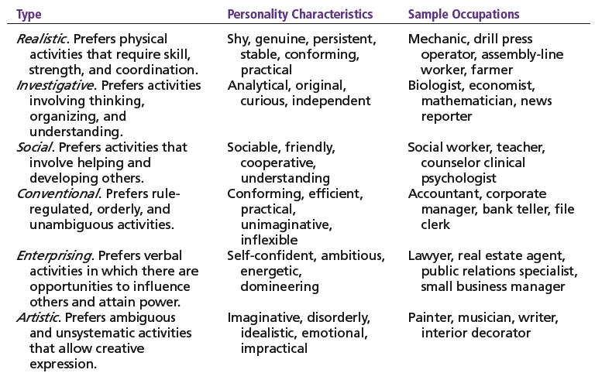
Exhibit 13.5 Holland’s Typology of Personality and Sample Occupations
Source: Based on J. L. Holland, Making Vocational Choices: A Theory of Vocational Personalities and Work Environments (Odessa, FL: Psychological Assessment Resources, 1997).
Copyright © 2010 Pearson Education, Inc. Publishing as Prentice Hall
13–35
Notes:
35

Slide 36
Psychological Factors – Perception
Perception
A process by which individuals give meaning (reality) to their environment by organizing and interpreting their sensory impressions.
Factors influencing perception:
The perceiver’s personal characteristics—interests, biases and expectations
The target’s characteristics—distinctiveness, contrast, and similarity
The situation (context) factors—place, time, location—draw attention or distract from the target
Copyright © 2010 Pearson Education, Inc. Publishing as Prentice Hall
13–36
Notes:
36

Slide 37
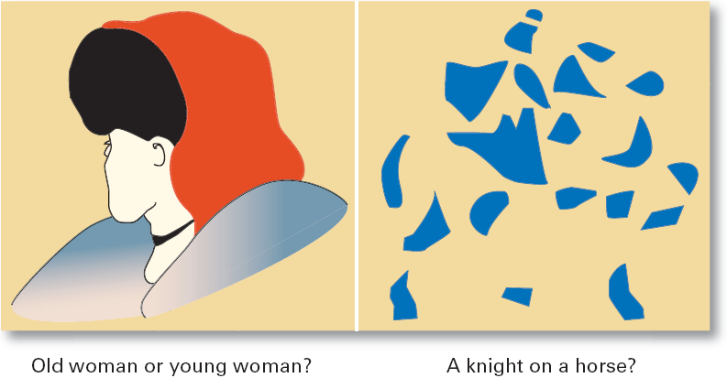
Exhibit 13.6 Perception Challenges: What Do You See?
Copyright © 2010 Pearson Education, Inc. Publishing as Prentice Hall
13–37
Notes:
37

Slide 38
How We Perceive People
Attribution Theory
How the actions of individuals are perceived by others depends on what meaning (causation) we attribute to a given behavior.
Internally caused behavior: under the individual’s control
Externally caused behavior: due to outside factors
Determining the source of behaviors:
Distinctiveness: different behaviors in different situations
Consensus: behaviors similar to others in same situation
Consistency: regularity of the same behavior over time
Copyright © 2010 Pearson Education, Inc. Publishing as Prentice Hall
13–38
Notes:
38

Slide 39
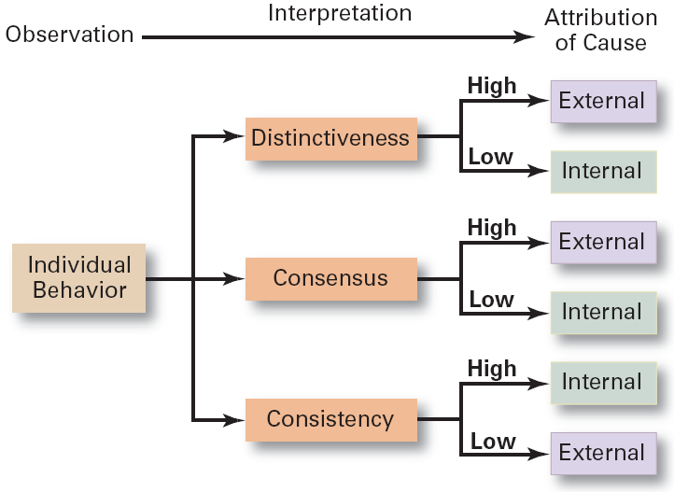
Exhibit 13.7 Attribution Theory
Copyright © 2010 Pearson Education, Inc. Publishing as Prentice Hall
13–39
Notes:
39

Slide 40
How We Perceive People (cont’d)
Attribution Theory – errors and biases (cont’d)
Fundamental attribution error
The tendency to underestimate the influence of external factors and to overestimate the influence of internal or personal factors.
Self-serving bias
The tendency of individuals to attribute their successes to internal factors while blaming personal failures on external factors.
Copyright © 2010 Pearson Education, Inc. Publishing as Prentice Hall
13–40
Notes:
40

Slide 41
Shortcuts Used in Judging Others
Assumed Similarity
Assuming that others are more like us than they actually are.
Stereotyping
Judging someone on the basis of our perception of a group he or she is a part of.
Halo Effect
Forming a general impression of a person on the basis of a single characteristic of that person.
Copyright © 2010 Pearson Education, Inc. Publishing as Prentice Hall
13–41
Notes:
41

Slide 42
Implications for Managers
Employees react to perceptions
Pay close attention to how employees perceive their jobs and management actions
Copyright © 2010 Pearson Education, Inc. Publishing as Prentice Hall
13–42

Slide 43
Psychological Factors – Learning
Learning
Any relatively permanent change in behavior that occurs as a result of experience.
Almost all complex behavior is learned.
Learning is a continuous, life-long process.
The principles of learning can be used to shape behavior.
Theories of learning:
Operant conditioning
Social learning
Copyright © 2010 Pearson Education, Inc. Publishing as Prentice Hall
13–43
Notes:
43

Slide 44
Learning (cont’d)
Operant Conditioning (B.F. Skinner)
The theory that behavior is a function of its consequences and is learned through experience.
Operant behavior: voluntary or learned behaviors
Behaviors are learned by making rewards contingent to behaviors.
Behavior that is rewarded (positively reinforced) is likely to be repeated.
Behavior that is punished or ignored is less likely to be repeated.
Copyright © 2010 Pearson Education, Inc. Publishing as Prentice Hall
13–44
Notes:
44

Slide 45
Learning (cont’d)
Social Learning
The theory that individuals learn through their observations of others and through their direct experiences.
Attributes of models that influence learning:
Attentional: the attractiveness or similarity of the model
Retention: how well the model can be recalled
Motor reproduction: the reproducibility of the model’s actions
Reinforcement: the rewards associated with learning the model behavior
Copyright © 2010 Pearson Education, Inc. Publishing as Prentice Hall
13–45
Notes:
45

Slide 46
Shaping: A Managerial Tool
Shaping Behavior
Attempting to “mold” individuals by guiding their learning in graduated steps such that they learn to behave in ways that most benefit the organization.
Shaping methods:
Positive reinforcement: rewarding desired behaviors.
Negative reinforcement: removing an unpleasant consequence once the desired behavior is exhibited.
Punishment: penalizing an undesired behavior.
Extinction: eliminating a reinforcement for an undesired behavior.
Copyright © 2010 Pearson Education, Inc. Publishing as Prentice Hall
13–46
Notes:
46

Slide 47
Implications for Managers
If managers want behavior A but reward behavior B, employees will engage in behavior B.
Employees will look to managers as models. Good manager behavior will promote good employee behavior.
Copyright © 2010 Pearson Education, Inc. Publishing as Prentice Hall
13–47

Slide 48
Contemporary Issues in OB
Managing Generational Differences in the Workplace
Gen Y: individuals born after 1978
Bring new attitudes to the workplace that reflect wide arrays of experiences and opportunities
Want to work, but don’t want work to be their life
Challenge the status quo
Have grown up with technology
Copyright © 2010 Pearson Education, Inc. Publishing as Prentice Hall
13–48
Notes:
48

Slide 49
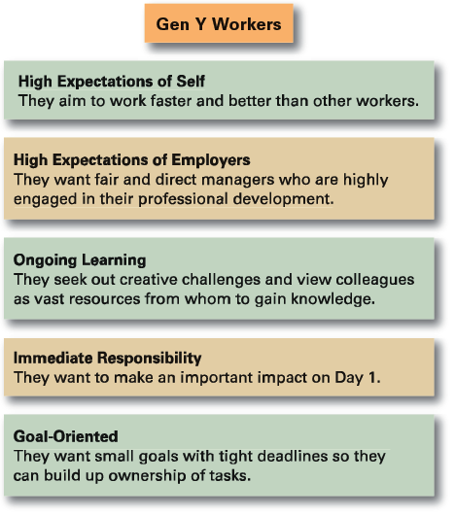
Exhibit 13.8 Gen Y Workers
Source: Bruce Tulgan of Rainmaker Thinking. Used with permission.
13–49
Copyright © 2010 Pearson Education, Inc. Publishing as Prentice Hall
Notes:
49

Slide 50
Contemporary Issues in OB
Managing Negative Behavior in the Workplace
Tolerating negative behavior sends the wrong message to other employees
Both preventive and responsive actions to negative behaviors are needed:
Screening potential employees
Responding immediately and decisively to unacceptable behavior
Paying attention to employee attitudes
Copyright © 2010 Pearson Education, Inc. Publishing as Prentice Hall
13–50
Notes:
50

